Slide 1
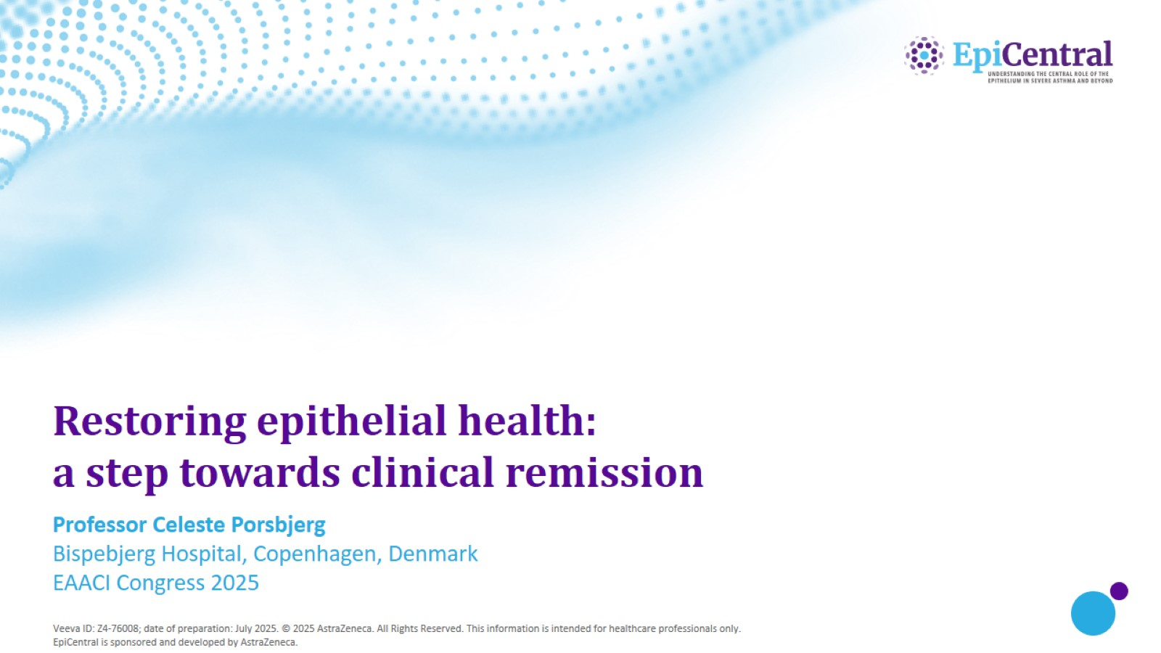
Restoring epithelial health: a step towards clinical remission

Slide 2
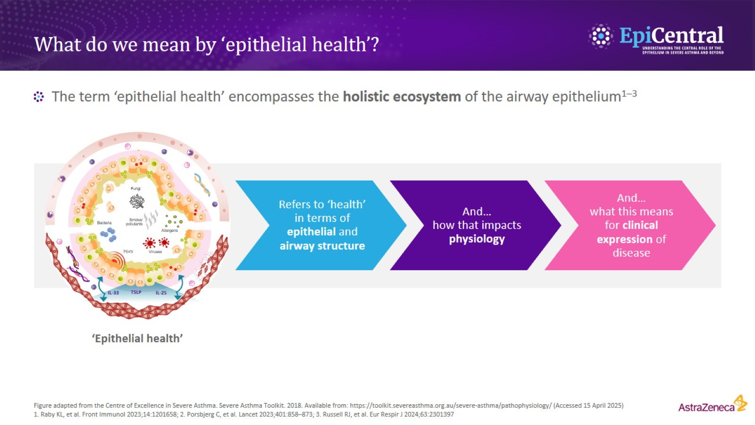
What do we mean by ‘epithelial health’?

Slide 3
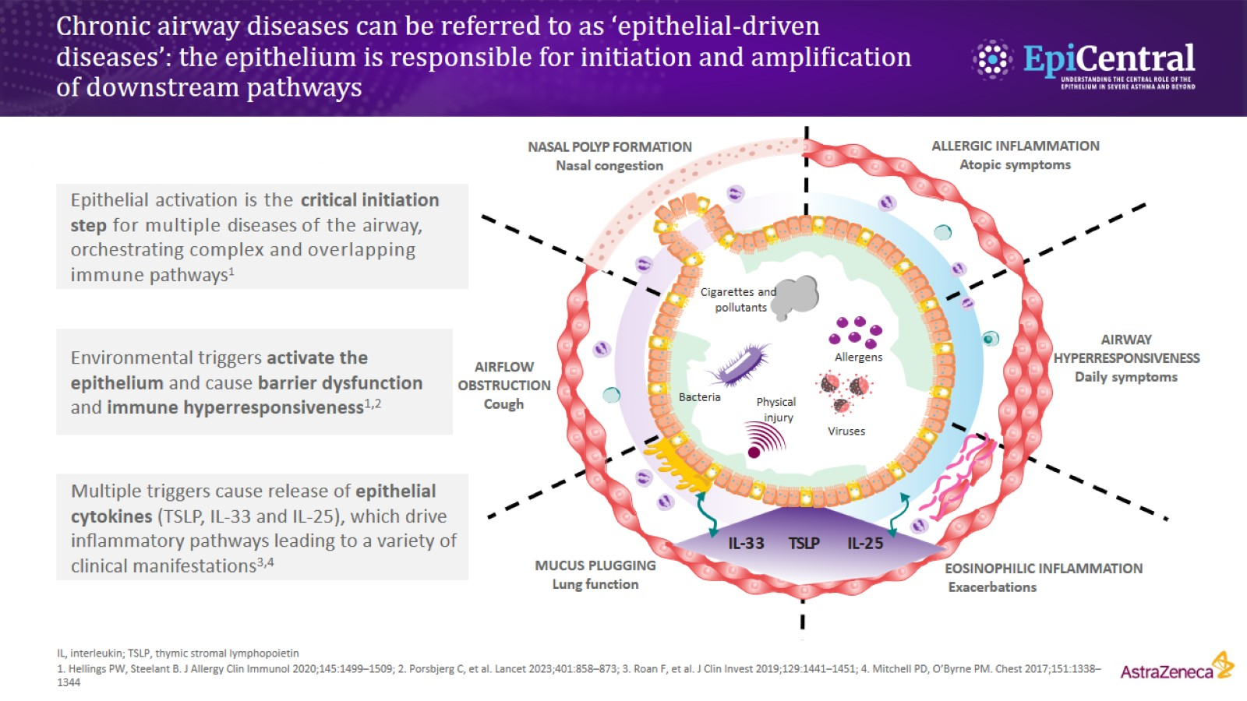
Chronic airway diseases can be referred to as ‘epithelial-driven diseases’: the epithelium is responsible for initiation and ampliﬁcation of downstream pathways

Slide 4
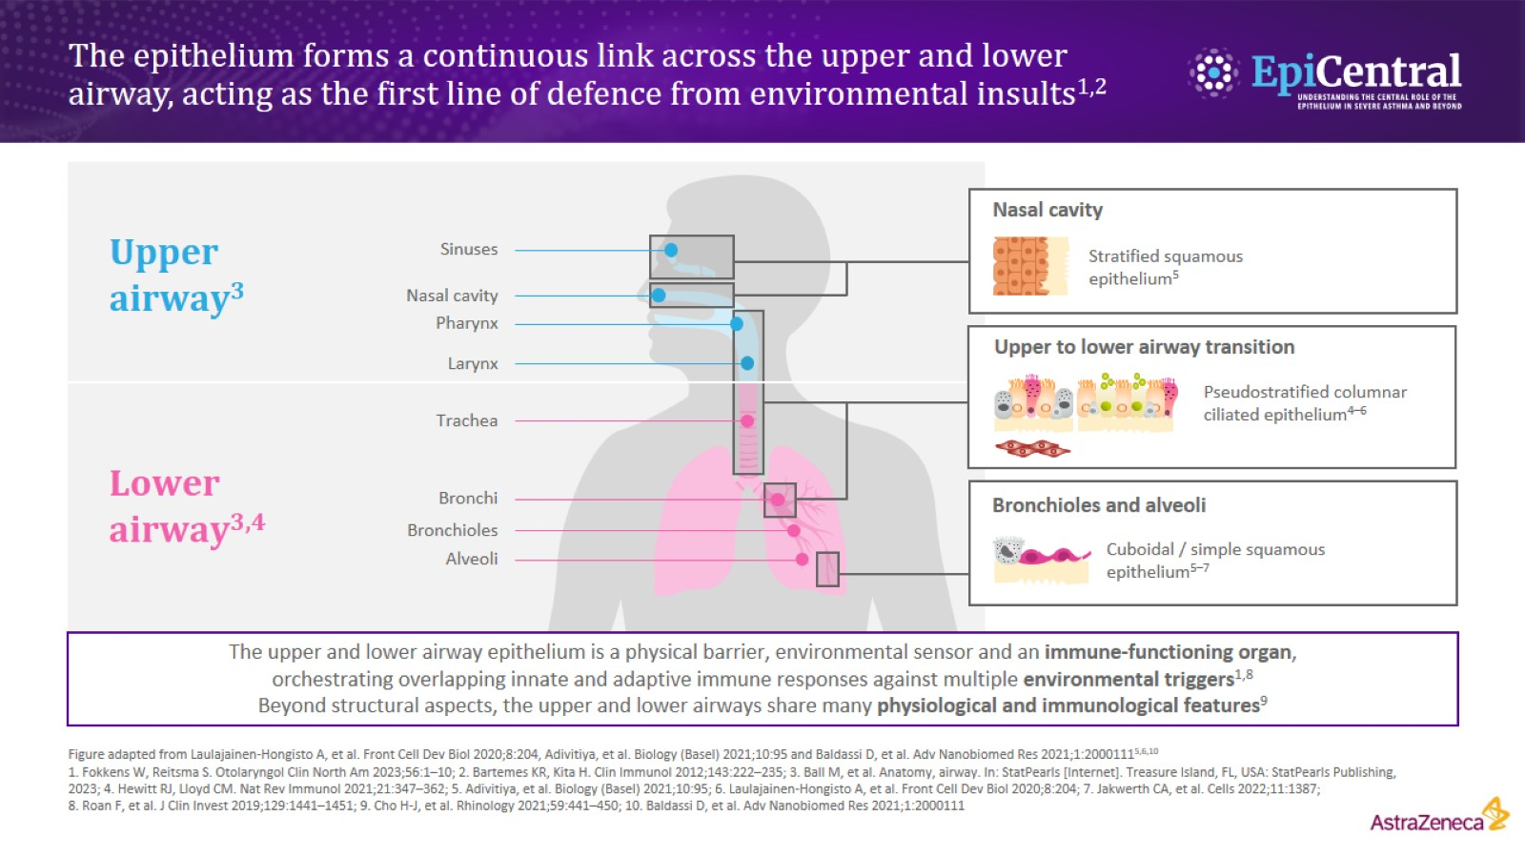
The epithelium forms a continuous link across the upper and lower airway, acting as the first line of defence from environmental insults^{1,2}

Slide 5
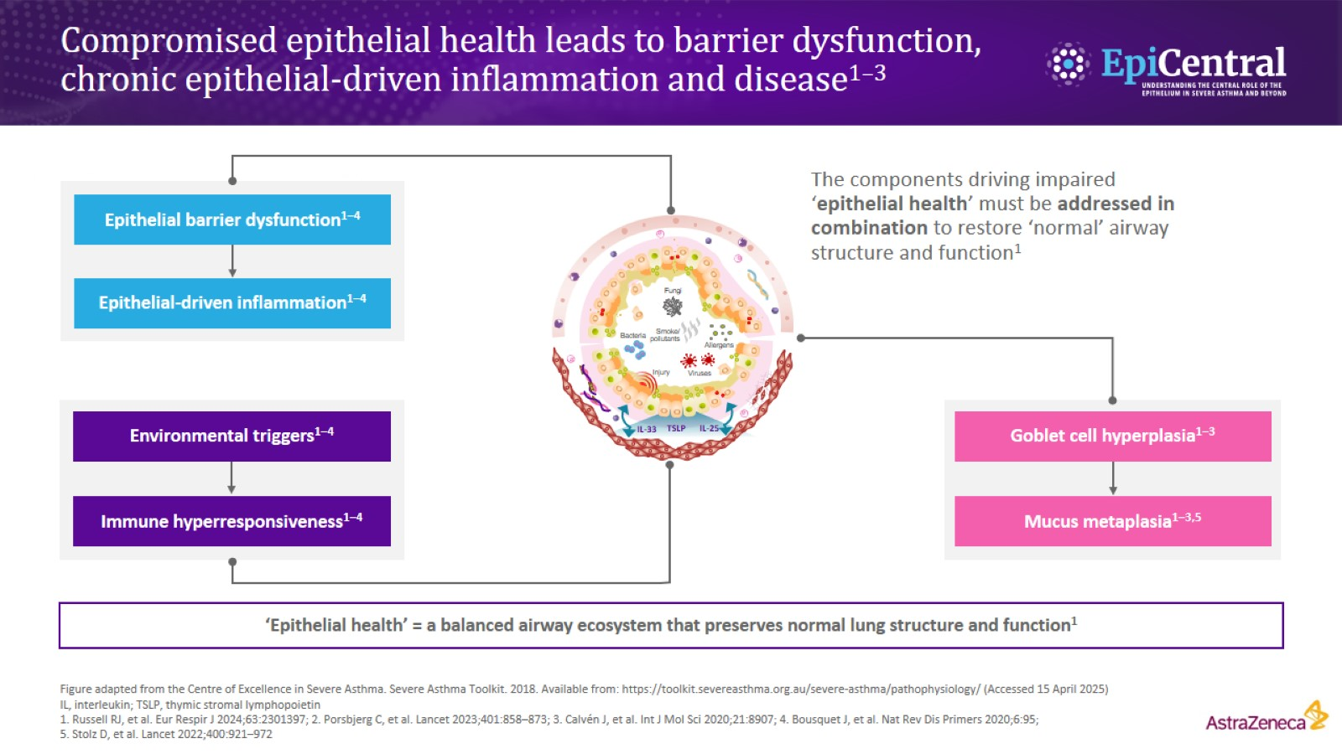
Compromised epithelial health leads to barrier dysfunction, chronic epithelial-driven inflammation and disease^{1–3}

Slide 6
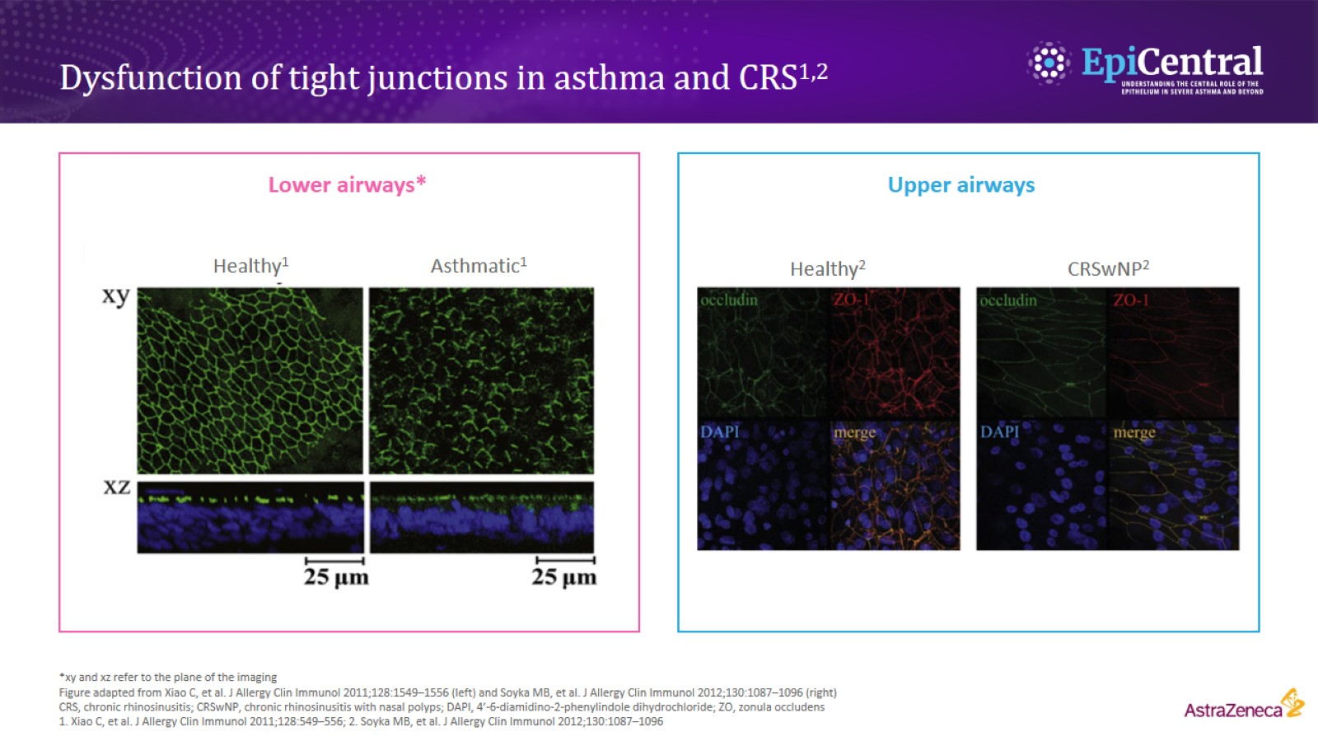
Dysfunction of tight junctions in asthma and CRS^{1,2}

Slide 7
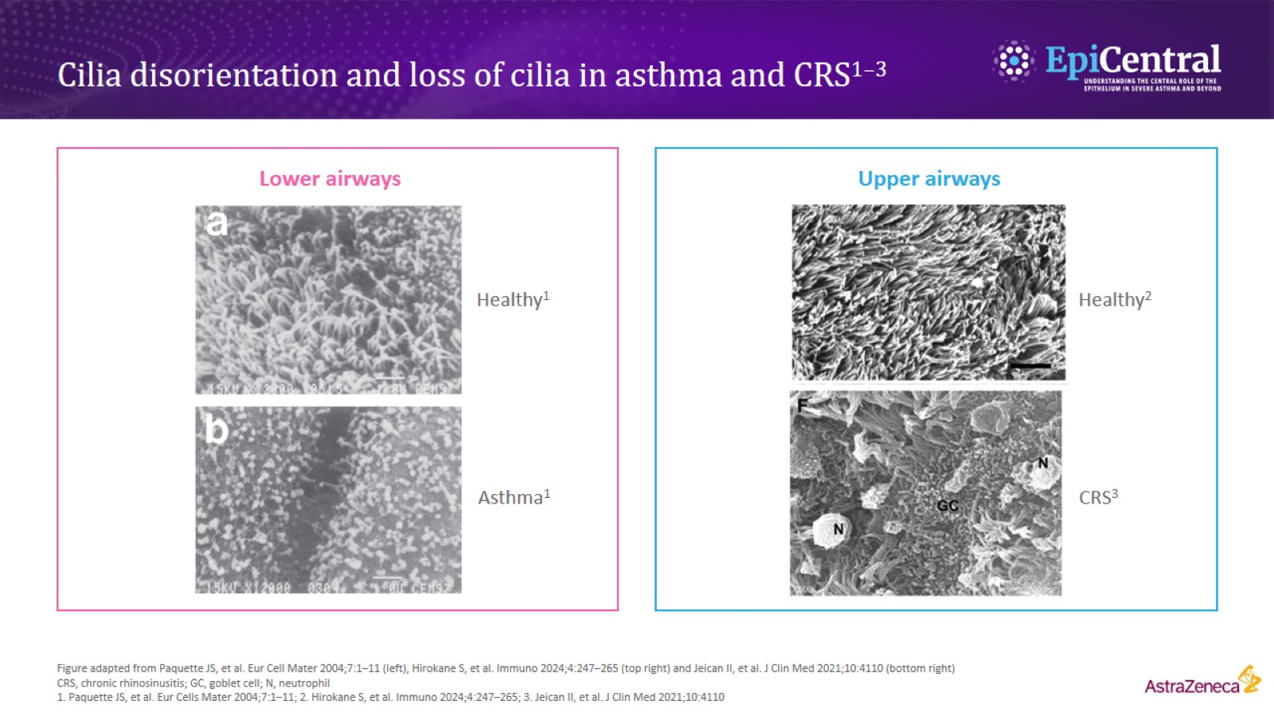
Cilia disorientation and loss of cilia in asthma and CRS^{1–3}

Slide 8
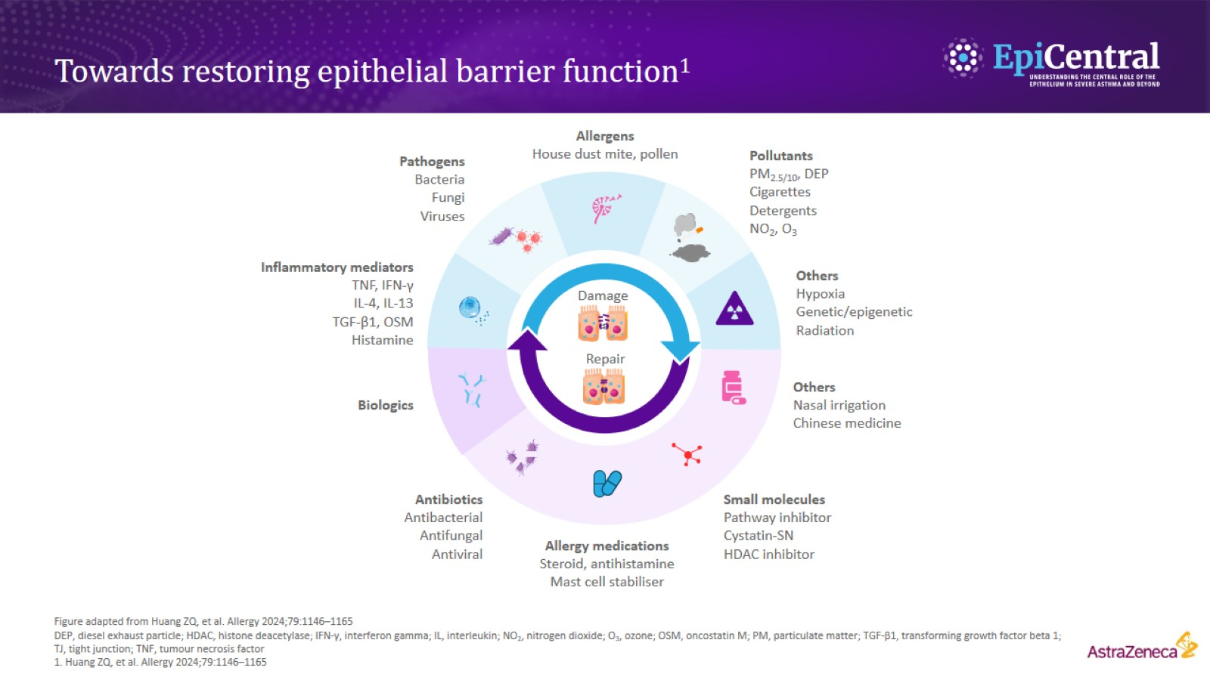
Towards restoring epithelial barrier function¹

Slide 9
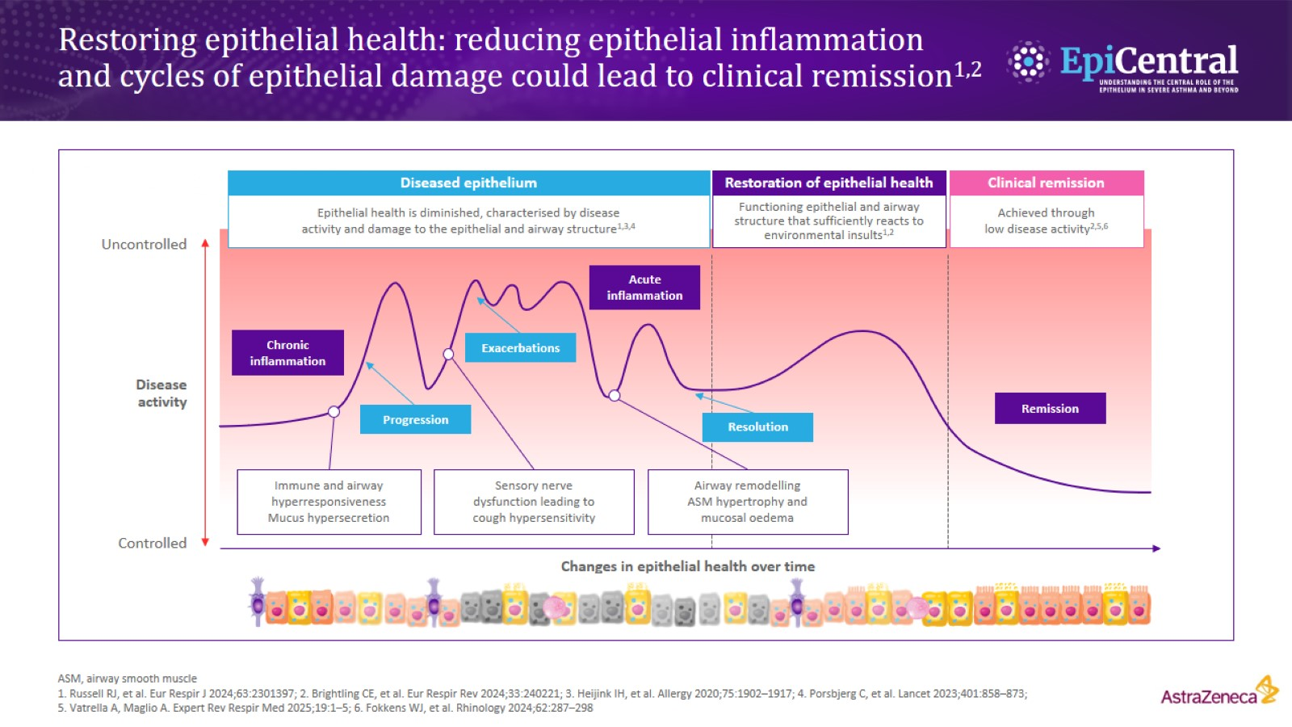
Restoring epithelial health: reducing epithelial inflammation and cycles of epithelial damage could lead to clinical remission^{1,2}

Slide 10
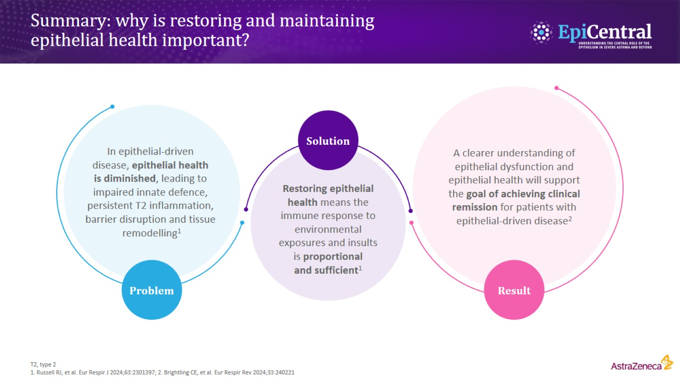
Summary: why is restoring and maintaining epithelial health important?

Slide 11
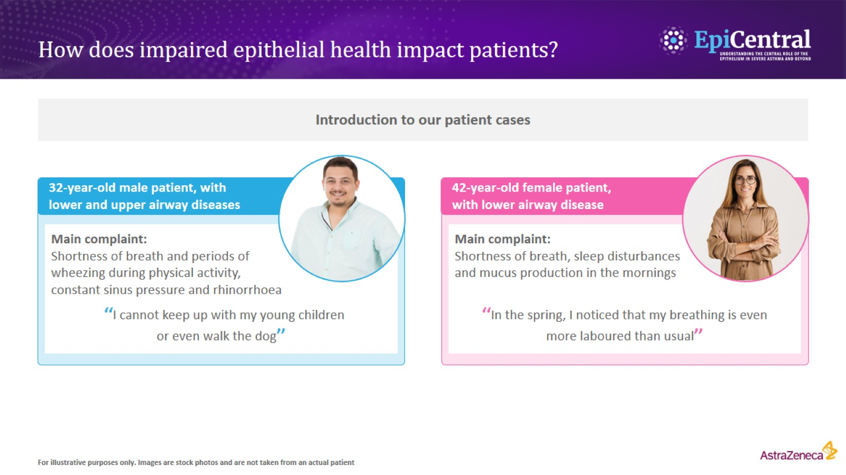
How does impaired epithelial health impact patients?

Slide 12
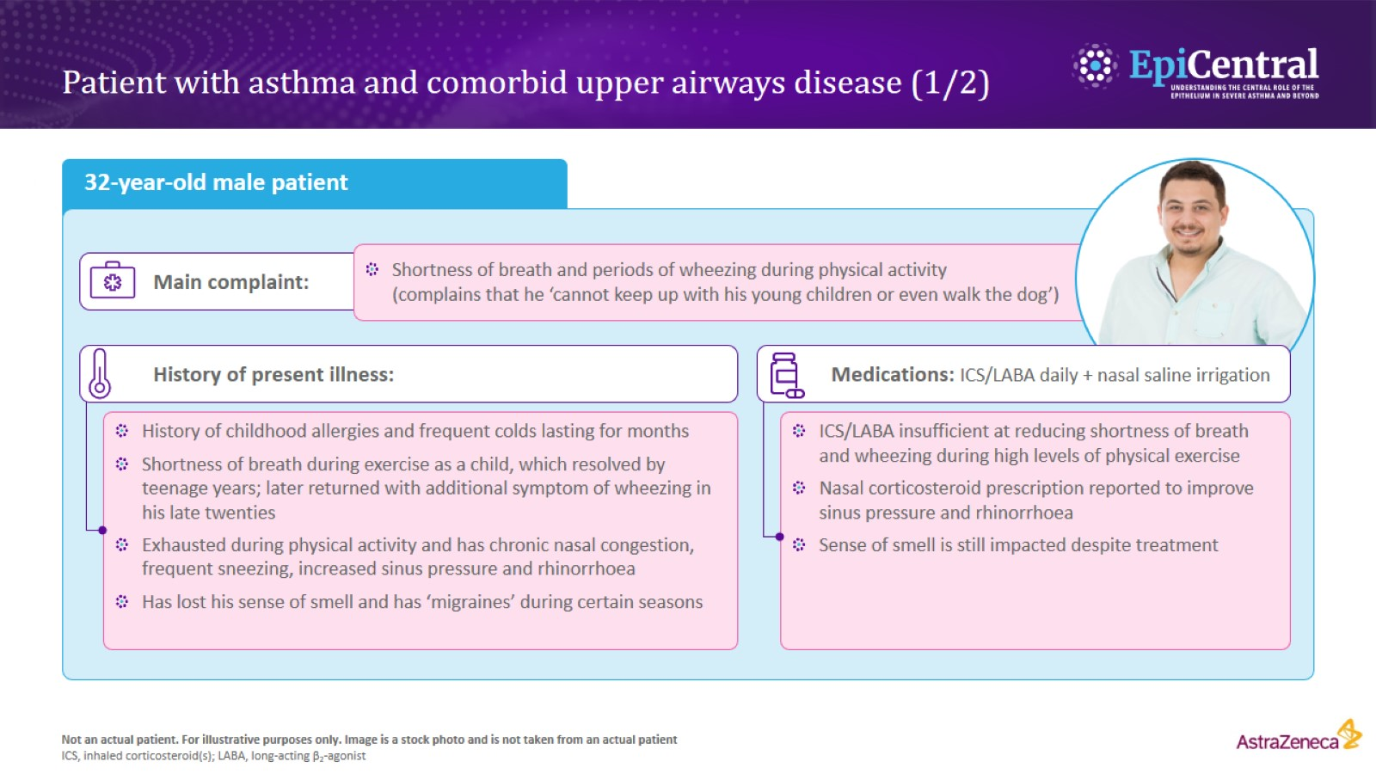
Patient with asthma and comorbid upper airways disease (1/2)

Slide 13
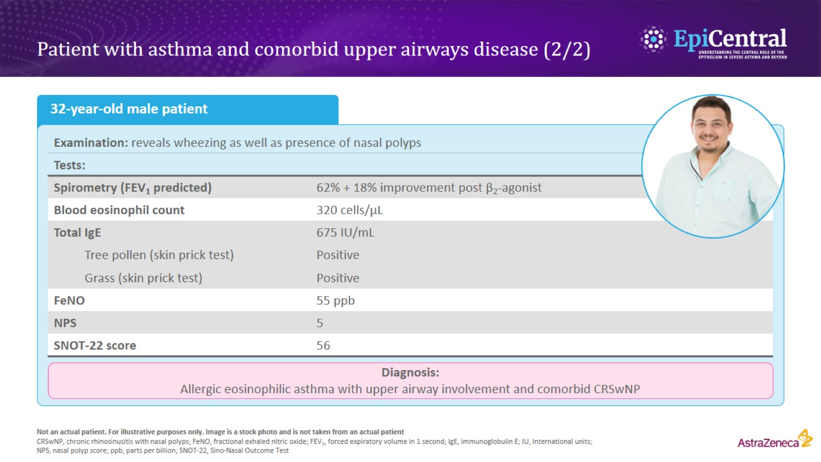
Patient with asthma and comorbid upper airways disease (2/2)

Slide 14
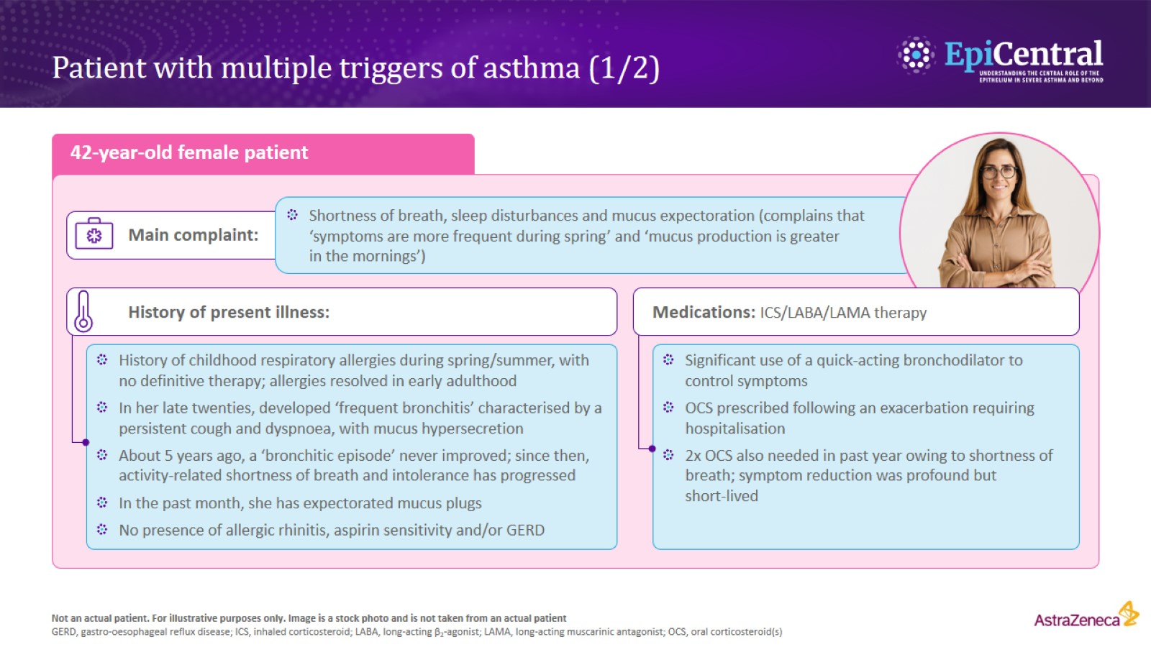
Patient with multiple triggers of asthma (1/2)

Slide 15
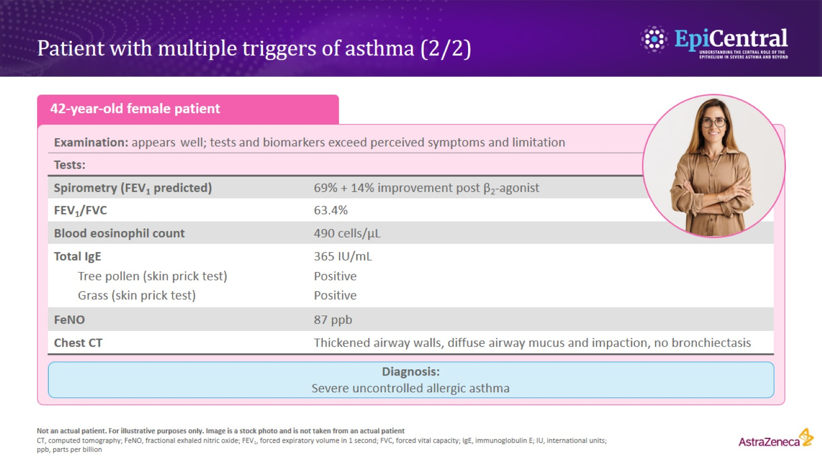
Patient with multiple triggers of asthma (2/2)

